Slide 1
Disability is Associated with Poor Mental Health in Harris County
Daniel Brock
3/22/2023

Slide 2

Houston State of Health Data
Collaborative project between Houston Health Department, Harris County Public Health Department, Harris Health system, Houston Methodist Hospital system and Memorial Herman Hospital system.
Goal: to understand public health indicators affecting the quality of life in Houston.
Notes:
Source: https://www.houstonstateofhealth.com/
Quality of Life in Houston includes mental health

Slide 3
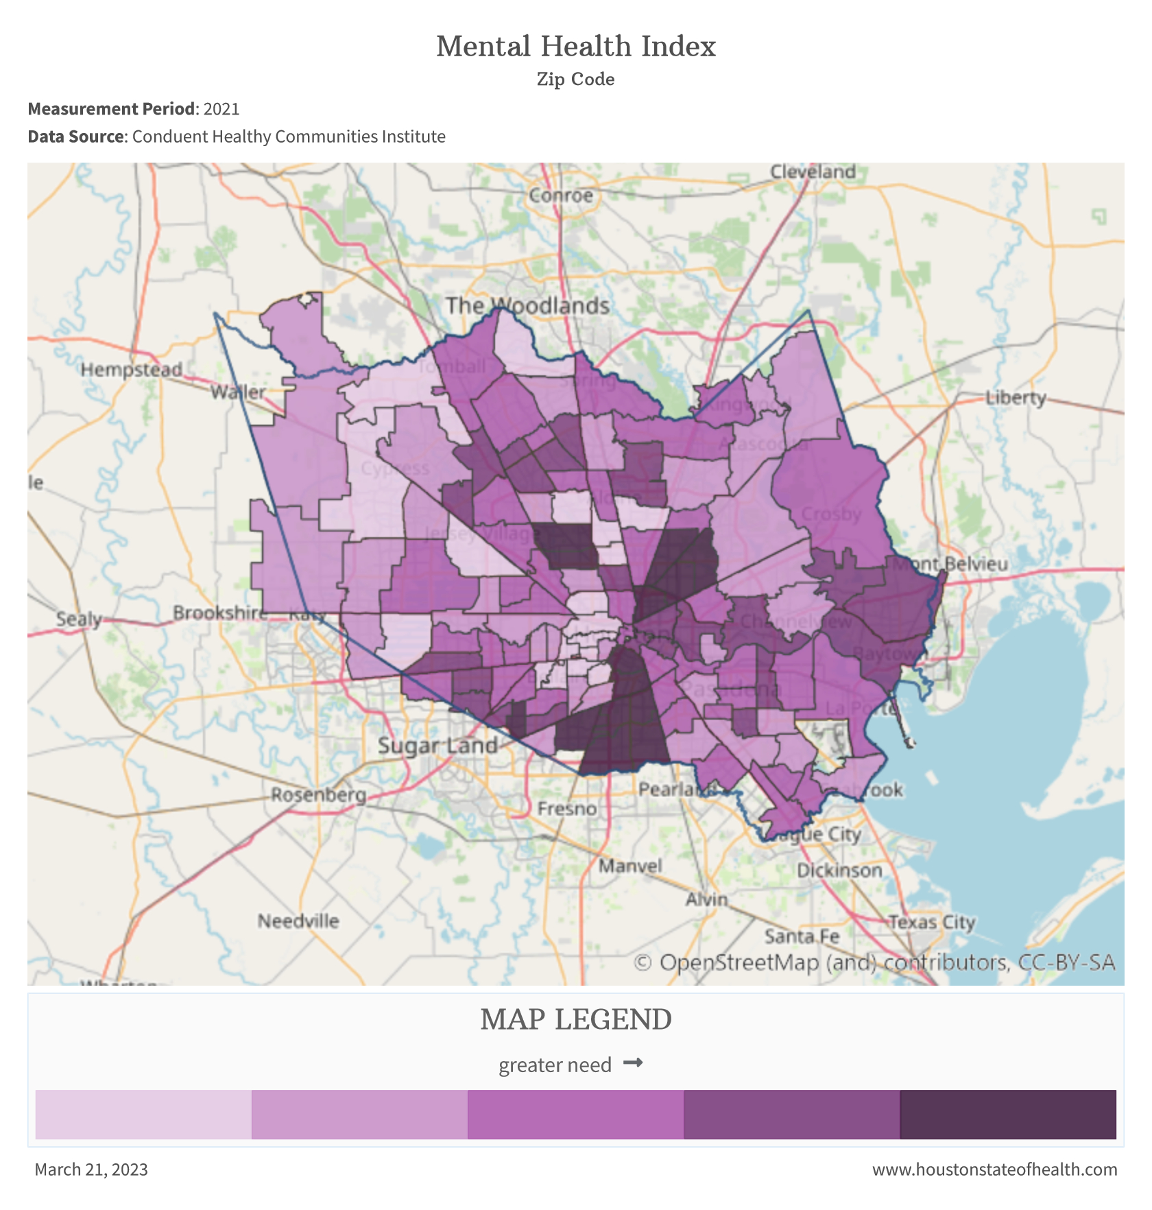
Mental Health Index
Zip-code level analysis of mental health: 128 zip codes.
Higher numbers (darker shaded zip codes) are associated with poor mental health.
Notes:
Source: https://www.houstonstateofhealth.com/indexsuite/index/mentalhealth
The 2021 Mental Health Index, created by Conduent Healthy Communities Institute, is a measure of socioeconomic and health factors correlated with self-reported poor mental health. The index is part of the Conduent's SocioNeeds Index® Suite, which provides analytics around social determinants of health to advance equitable outcomes for a range of topics.​
Conduent Health Communities Institute
SocioNeeds Index Suite
CDC questionnaires in public schools

Slide 4

What are the most significant social determinants of health correlated with Mental Health Index?
X
SDOH Factors
Mental Health Index

Slide 5
SDOH Factors from US Census Bereau
Data from the 2021 American Community Survey Data including:
Employment status
Demographics
Household Income
Education Level
Transportation
Insurance Status
Notes:
Source: https://www.census.gov/programs-surveys/acs/data.html
Tables:
Selected social characteristics
Selected economic characteristics
Selected housing characteristics
Demographic and housing estimates

Slide 6
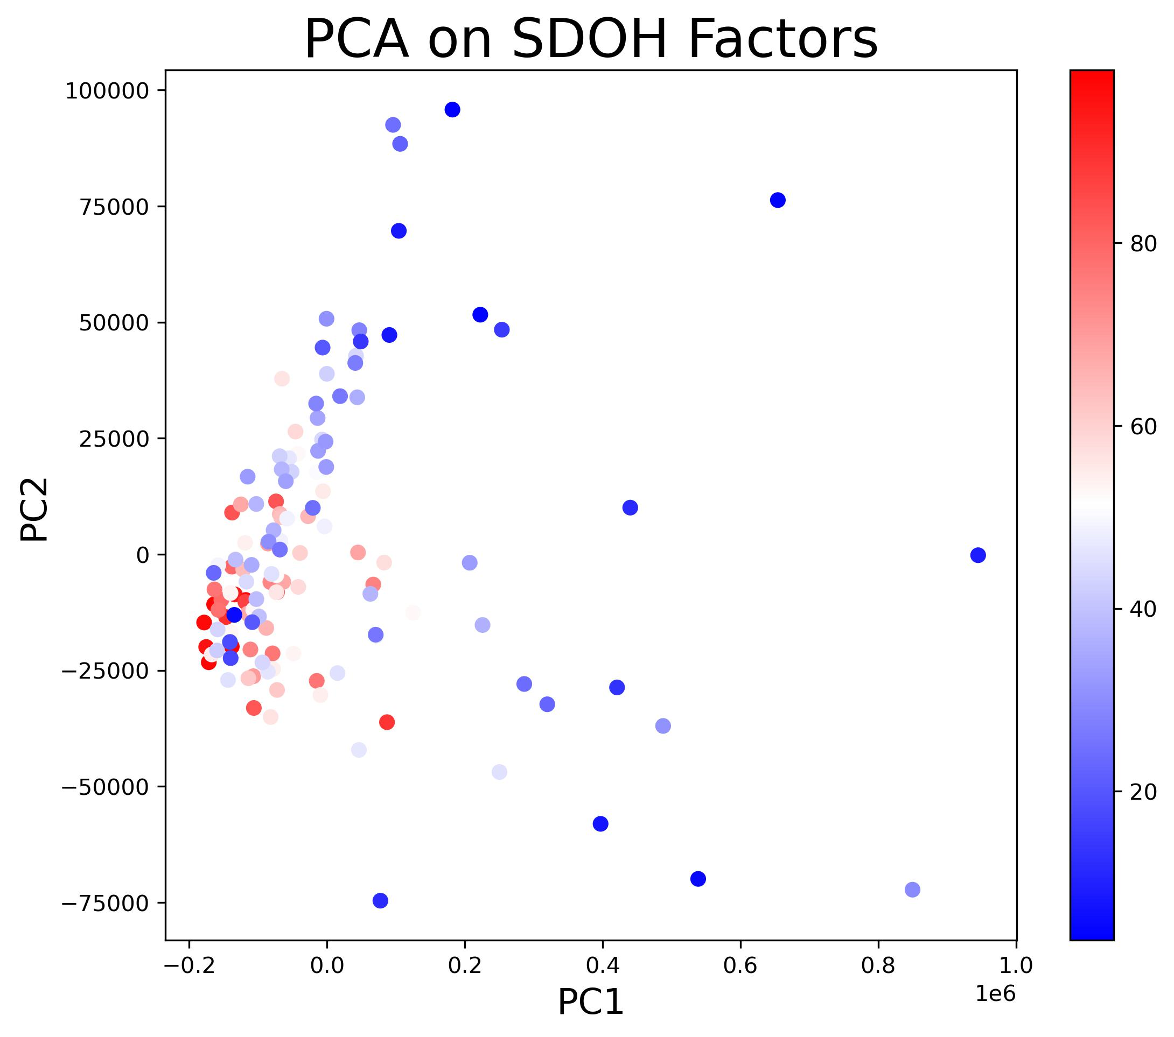
PCA of SDOH Factors per Zip Code
Notes:
I converted all population-level data to percents to make things relative for different sized zip codes.
Outlier is Rice Village and Bellaire 🤣

Slide 7
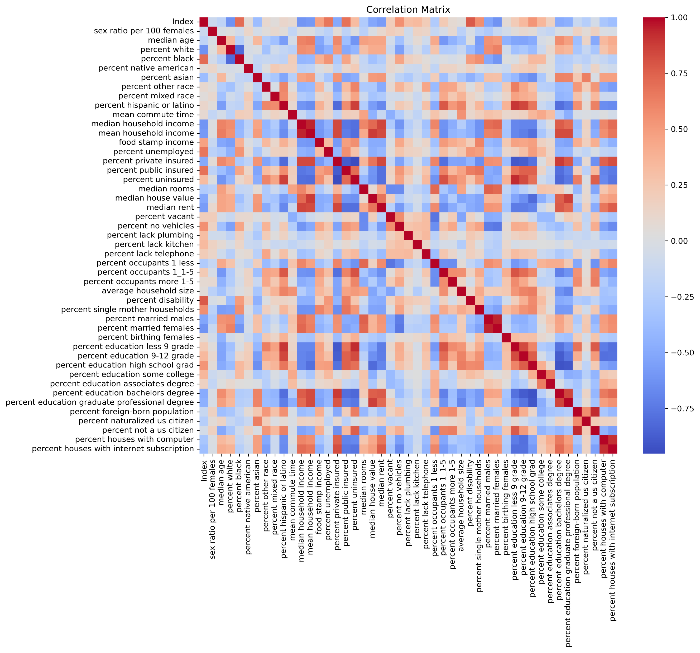
Correlation Analysis
Notes:
The Pearson correlation measures the strength of the linear relationship between two variables. It has a value between -1 to 1, with a value of -1 meaning a total negative linear correlation, 0 being no correlation, and + 1 meaning a total positive correlation.

Slide 8
Top 10 Most Significant Factors Correlated with Mental Health Index
US Census Factor | r | p-value
percent disability | 0.78 | 6.88E-27
percent black | 0.71 | 6.76E-21
percent public insured | 0.68 | 5.57E-19
percent unemployed | 0.67 | 4.26E-18
percent white | -0.63 | 1.25E-15
percent married females | -0.62 | 3.88E-15
median household income | -0.62 | 9.24E-15
median rent | -0.57 | 1.52E-12
percent single mother households | 0.56 | 3.92E-12
percent no vehicles | 0.55 | 1.63E-11
Notes:
The Pearson correlation measures the strength of the linear relationship between two variables. It has a value between -1 to 1, with a value of -1 meaning a total negative linear correlation, 0 being no correlation, and + 1 meaning a total positive correlation.

Slide 9
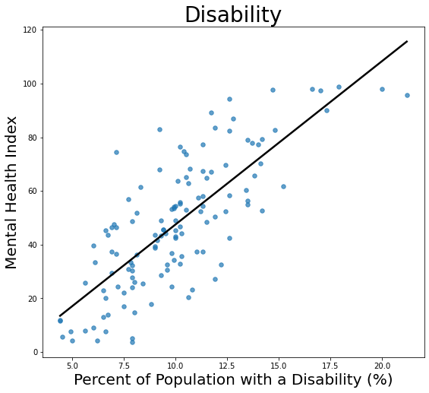
Disability Status is Correlated with Mental Health Index
r = 0.78
p-value = 6.88E-27
Notes:
Disability is defined by the US Census Bureau as significant impairments in “hearing, vision, cognition, and ambulation”.

Slide 10
Resources that Support Mental Health in Houston’s Disabled Population
The Harris Center for Mental Health and IDD
Houston Center for Independent Living
Legacy Community Health
Mental Health America of Greater Houston
The Montrose Center
Notes:
The Harris Center

Slide 11

The Harris Center for Mental Health
Notes:
Important because it offers care for substance abuse (which may be caused by or is associated with disability). Also provides care for crisis intervention and help for those with legal issues.

Slide 12
Conclusions
Mental health varies by zip code in Harris county
Percentage of the Population with a Disability was strongly correlated with poor mental health
The Harris Center for Mental Health aims to assist those in need of mental healthcare, including underprivileged and incarcerated people
Questions?

